Slide 1
Database
Management System
Lecture - 30

Slide 2
Order By Example
Q: Display the students’ data in the ascending order of names
SELECT * from STUDENT
ORDER BY stName

Slide 3
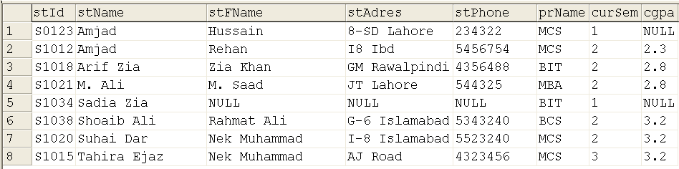

Slide 4
Practice Query
Display the name and cgpa of students for all those students who are in second or above semester in descending order of names

Slide 5
Functions in SQL
Built-in functions are pre-written programs to perform specific tasks
Accept certain arguments and return the result

Slide 6
Categories of Functions
Depending on the arguments and the return value, categorized
  Mathematical (ABS, ROUND, SIN, SQRT)
  String (LOWER, UPPER, SUBSTRING, LEN)
  Date (DATEDIFF, DATEPART, GETDATE())
  System (USER, DATALENGTH, HOST_NAME)
  Conversion (CAST, CONVERT)

Slide 7
Using Functions
SELECT upper(stName), lower(stFName), stAdres, len(convert(char, stAdres)),
FROM student

Slide 8
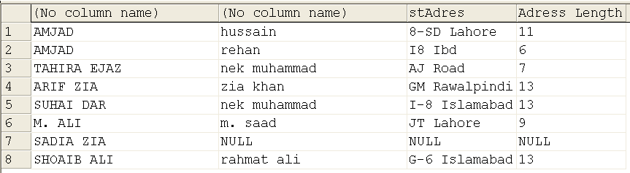

Slide 9
Aggregate Functions
Operate on a set of rows and return a single value, like, AVG, SUM, MAX, MIN, STDEV
Attribute list cannot contain other attributes if an aggregate function is being used

Slide 10
Aggregate Function Example
SELECT avg(cgpa) as 'Average CGPA', max(cgpa) as 'Maximum CGPA' from student
Output is……

Slide 11


Slide 12
Aggregate Function Example
SELECT avg(cgpa) as 'Average CGPA', max(cgpa) as 'Maximum CGPA' from student
SELECT convert( decimal(5,2), avg(cgpa)) as 'Average CGPA', max(cgpa) as 'Maximum CGPA' from student

Slide 13


Slide 14
Group By Clause
SELECT stName, avg(cgpa) as 'Average CGPA', max(cgpa) as 'Maximum CGPA' from student
SELECT prName, max(cgpa) as ‘Max CGPA', min(cgpa) as ‘Min CGPA'
FROM student GROUP BY prName

Slide 15
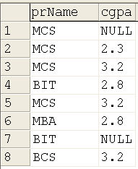
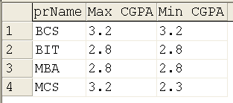

Slide 16
HAVING Clause
We can restrict groups by using having clause; groups satisfying having condition will be selected

Slide 17
HAVING Clause
SELECT select_list
[ INTO new_table ]
FROM table_source
[ WHERE search_condition ]
[ GROUP BY group_by_expression ]
[ HAVING search_condition ]
[ ORDER BY order_expression [ ASC | DESC ] ]

Slide 18
HAVING Example
SELECT prName, min(cgpa), max(cgpa)
FROM student
GROUP BY prName
HAVING max(cgpa) > 3

Slide 19

Where and having can be combined

Slide 20
Accessing Multiple Tables
Cartesian Product
Inner join
Outer Join
Full outer join
Semi Join
Natural Join

Slide 21
Cartesian Product
No specific command; Select is used
Simply give the names of the tables involved; Cartesian product will be produced

Slide 22
Cartesian Product
Produces m x n rows
Select * from program, course

Slide 23
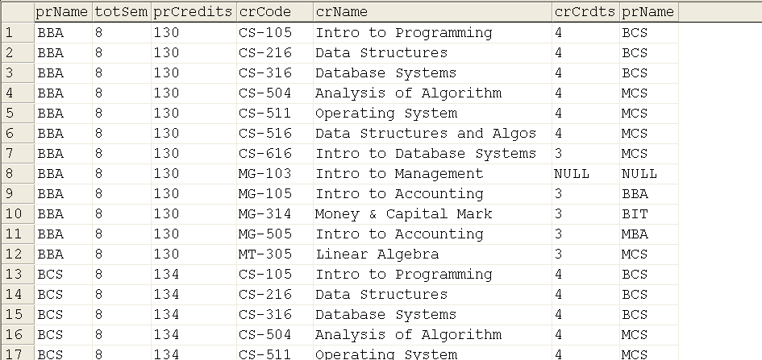

Slide 24
Cartesian Product
Certain columns can be selected, same column name needs to be qualified
Similarly can be applied to more than one tables, and even can be applied on the same table
SELECT * from Student, class, program

Slide 25
Database
Management System
Lecture - 30

